Slide 1

PURR-FECT PYTHON
a new career begins
by Lu Frazão

Slide 2

A beginner’s guide
Getting Started with Python
Welcome to the world of Python! Whether you're looking to embark on a new career path or simply expand your programming skills, Python is an excellent choice. But what exactly is Python, and why should you learn it?
Python is a powerful and versatile programming language known for its simplicity and readability. It was created in the late 1980s by Guido van Rossum and has since grown to become one of the most popular languages in the world. What sets Python apart is its clear and concise syntax, which makes it accessible even to those new to programming.

Slide 3

What and Why
What can Python be used for?
Python's versatility is one of its greatest strengths. Here are just a few areas where Python excels:
Web Development: Python frameworks like Django and Flask are widely used for building web applications.
Data Analysis and Visualization: Libraries such as Pandas, NumPy, and Matplotlib make Python indispensable for data science.
Artificial Intelligence and Machine Learning: Python's libraries like TensorFlow and PyTorch are at the forefront of AI and machine learning research and applications.
Automation: Python's simplicity and vast library support make it ideal for automating repetitive tasks.
Scripting: It's commonly used for writing scripts to automate system administration and other tasks.

Slide 4
What and Why
Why learn Python?
Learning Python opens up a world of opportunities. Whether you're interested in developing websites, analysing data, creating AI models, or simply automating everyday tasks, Python's flexibility and ease of use make it a valuable skill to have.
In this eBook, we’ll guide you through the essential concepts and commands of Python, providing clear explanations and real-life examples to help you grasp each topic. By the end, you'll have a solid foundation in Python programming, ready to take your next step towards a rewarding career in tech.
Let's dive in and explore the world of Python together!

Slide 5
PRINT
PRINT
01

Slide 6
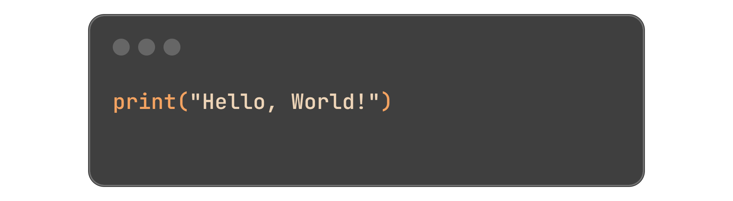
Speak your code
The ‘print()’ function
The print() function is one of the first things you'll learn in Python. It allows you to display text or variables on the screen.
Example:
Real-life Context:
Imagine you're creating a program that greets the user when they open it.
01

Slide 7
VARIABLES
VARIABLES
02

Slide 8
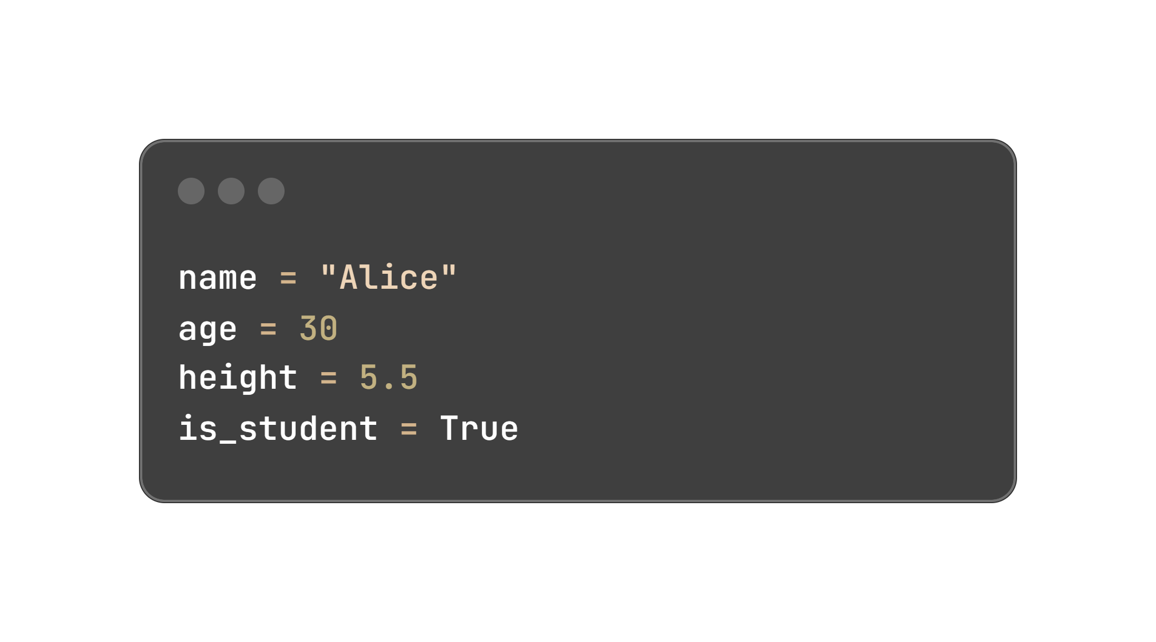
Storing information
Variables and Data Types
Variables are used to store data, and Python has several data types like integers, floats, strings, and booleans.
Example:
Real-life Context:
Think of an application that keeps track of user profiles.
02

Slide 9
LISTS
LISTS
03

Slide 10
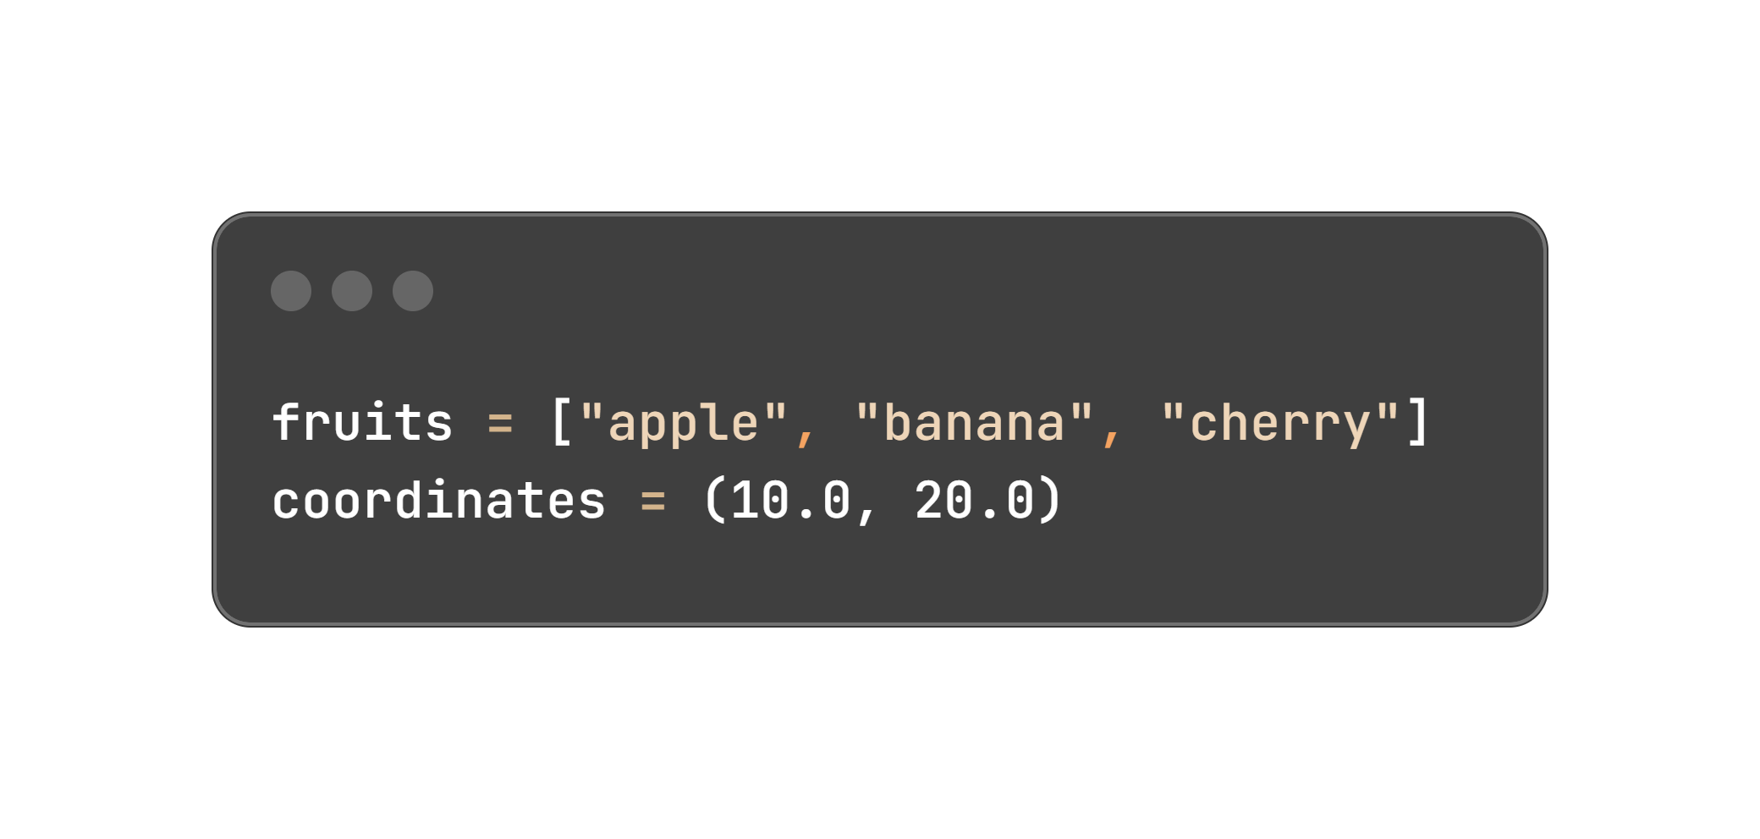
Collecting Data
Lists and Tuples
Lists and tuples are used to store collections of items.
Lists are mutable (changeable), while tuples are immutable (unchangeable).
Example:
Real-life Context:
Lists could be used for storing a shopping list, while tuples might store fixed geographical coordinates.
03

Slide 11
CONDITIONS
CONDITIONS
04

Slide 12
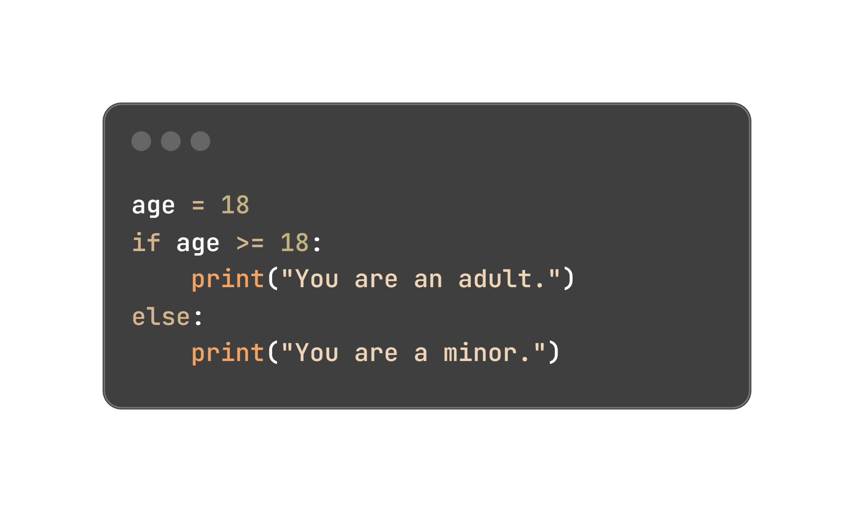
Making Decisions
‘if’, ‘elif’, and ‘else’
Conditional statements allow your program to make decisions based on certain conditions.
Example:
Real-life Context:
A program deciding if a user is eligible for a service based on their age.
04

Slide 13
LOOPS
LOOPS
05

Slide 14
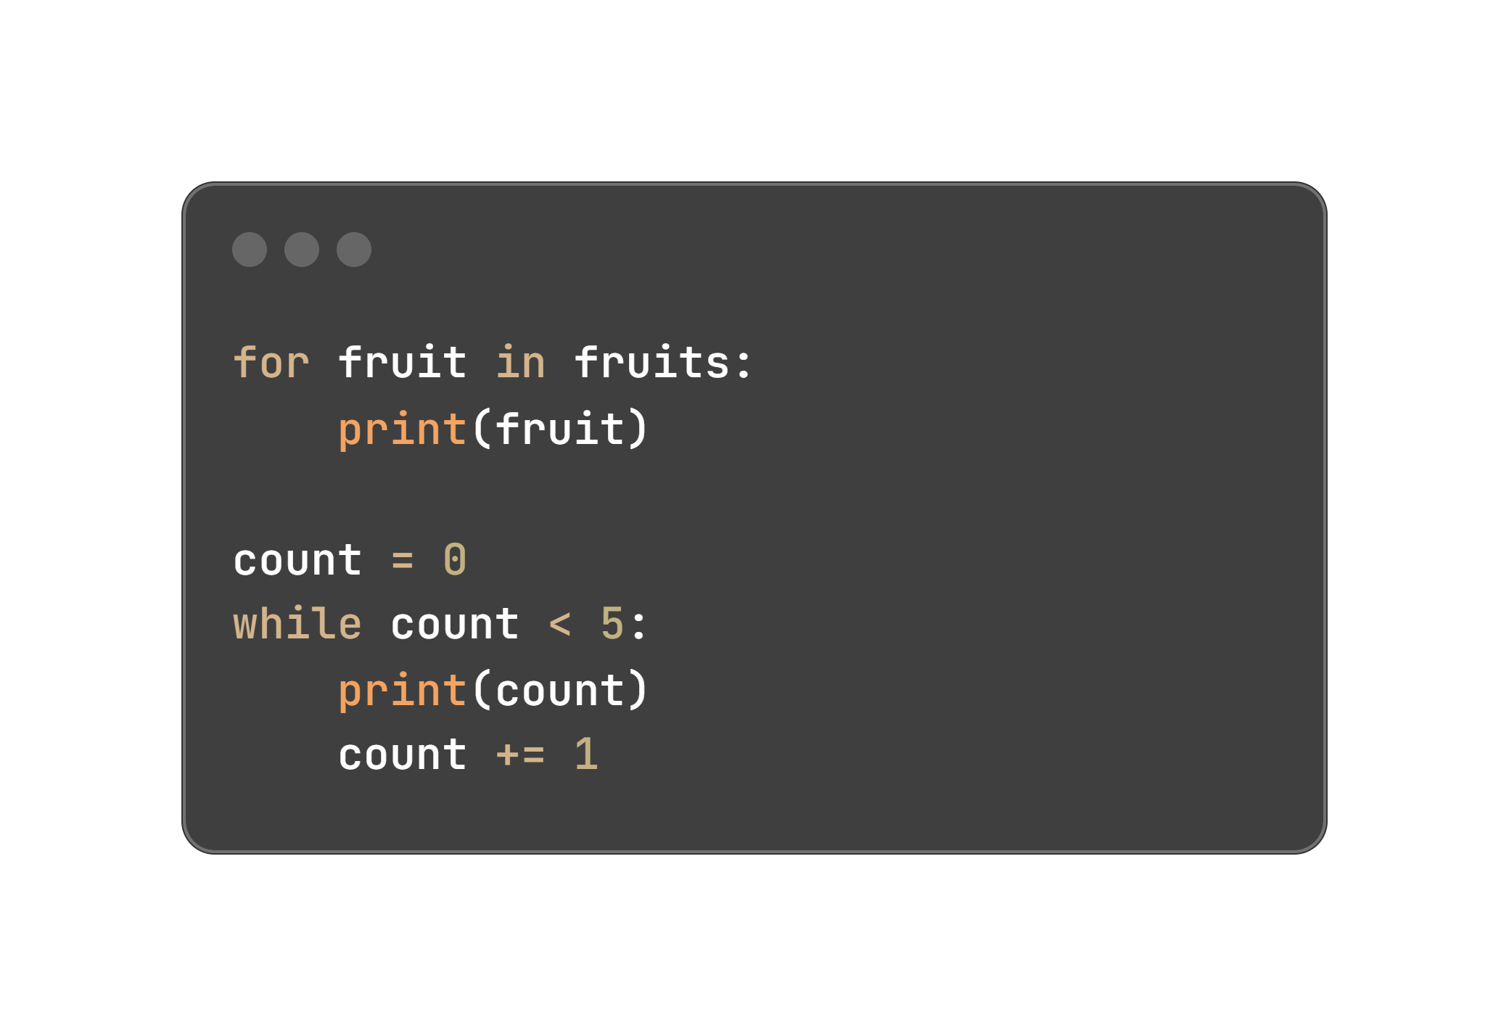
Automating Tasks
‘for’ and ‘while’ Loops
Loops allow you to repeat a block of code multiple times. The for loop is used for iterating over a sequence, while the while loop continues as long as a condition is true.
Example:
Real-life Context:
Automating the process of sending emails to a list of recipients.
05

Slide 15
THANK YOU
THANK YOU

Slide 16


Thanks for reading!
This eBook has been created using AI and designed by a human being. It has been created for educational purposes and might contain errors done by the AI.
Nonetheless, I do hope you enjoy it!
That’s me, Lu Frazão 🙃

